Slide 1


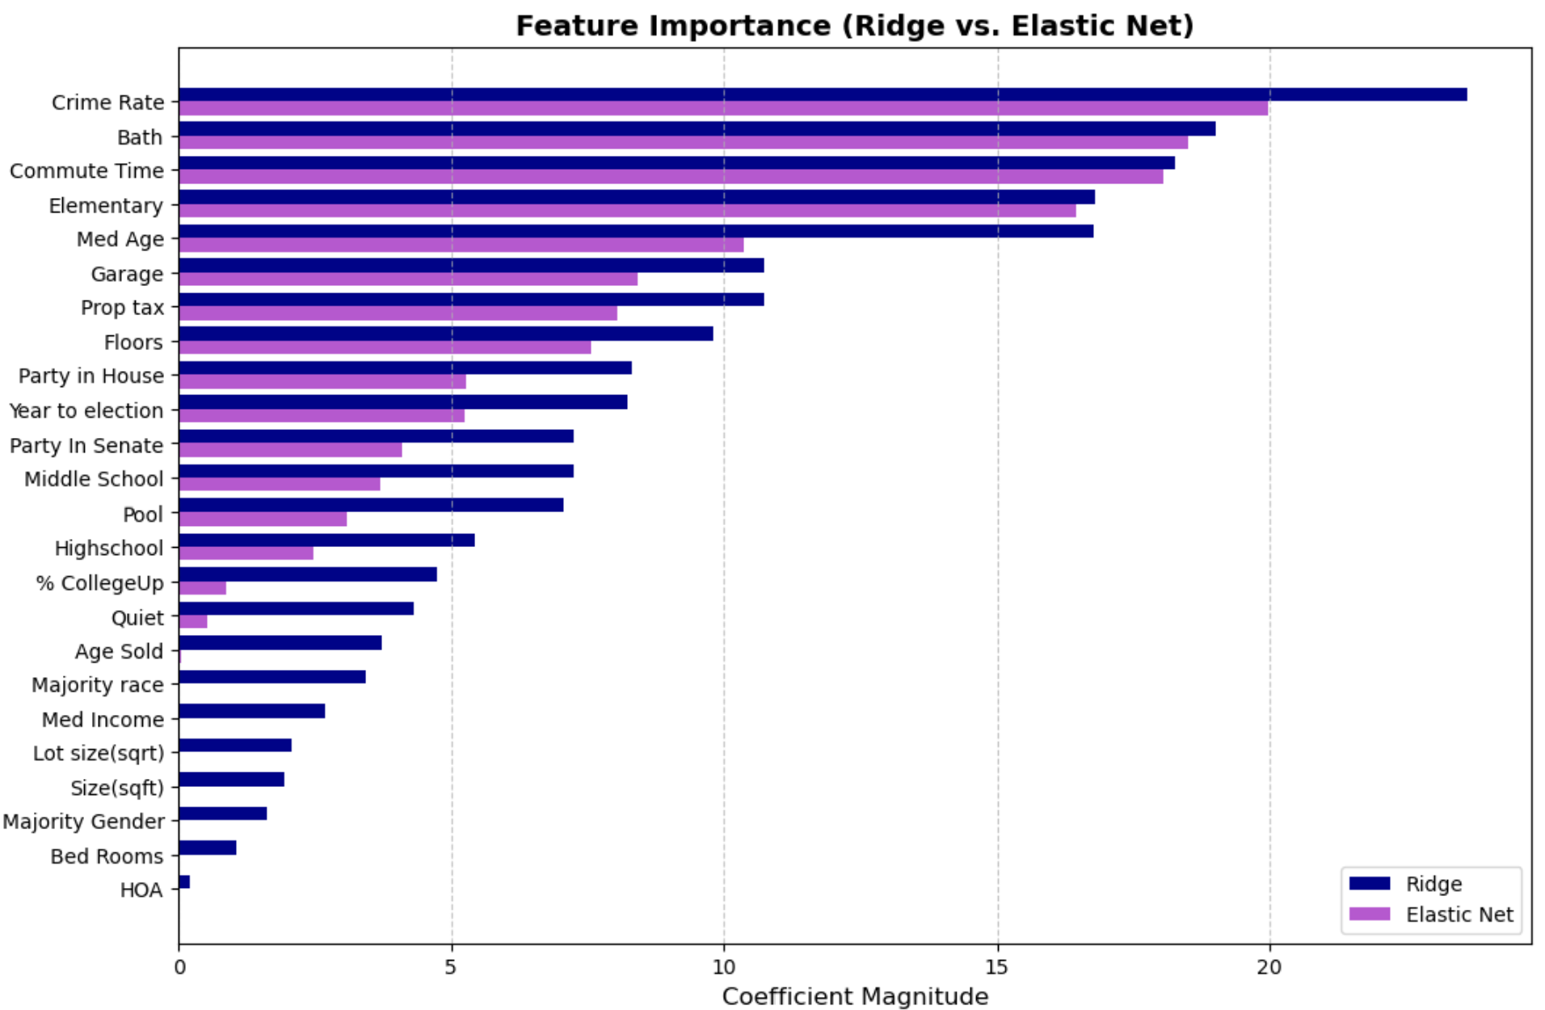

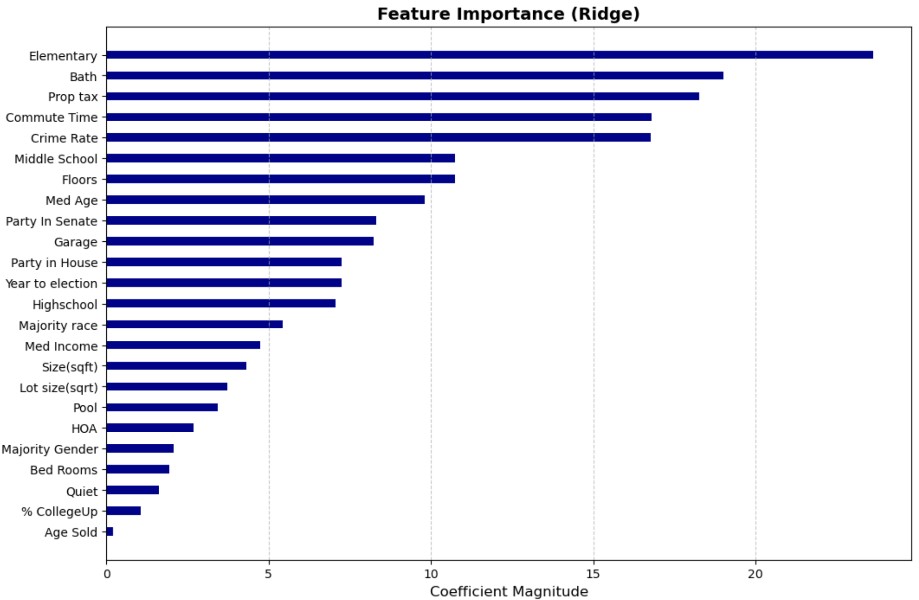
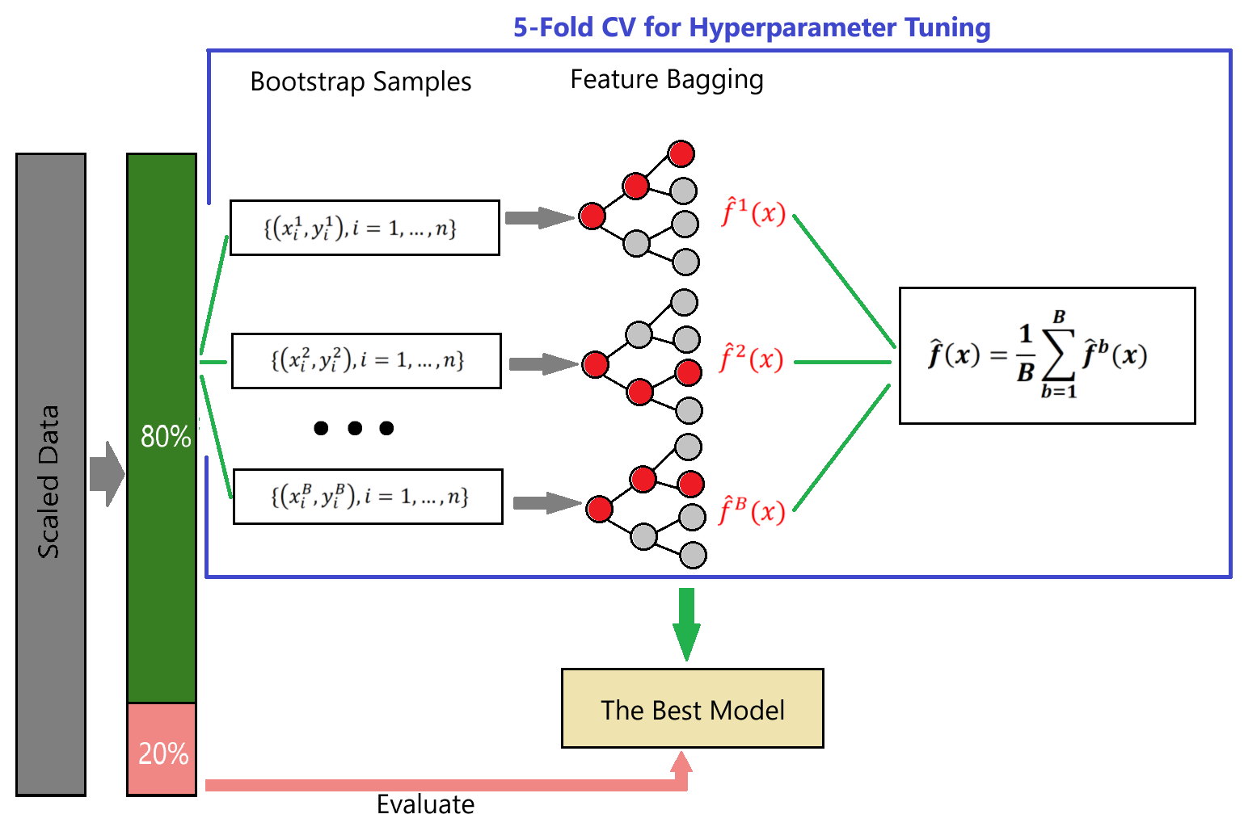
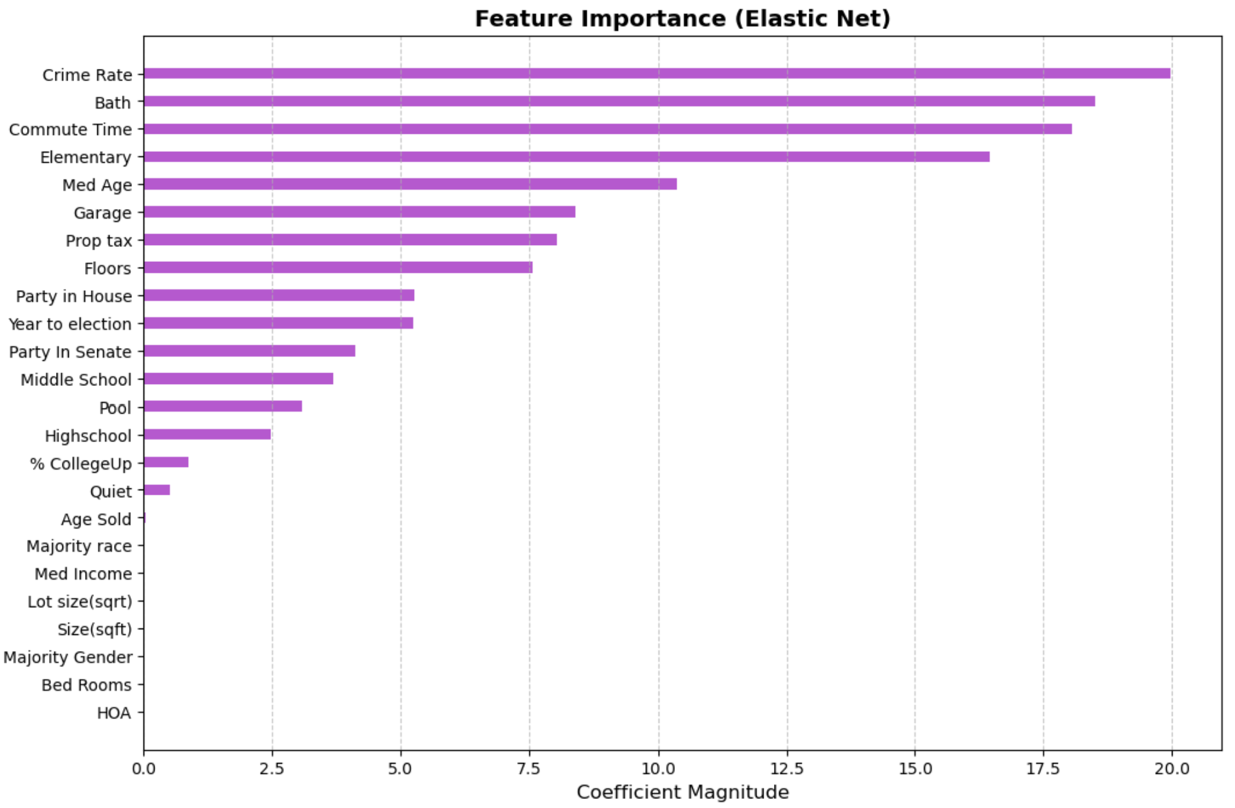
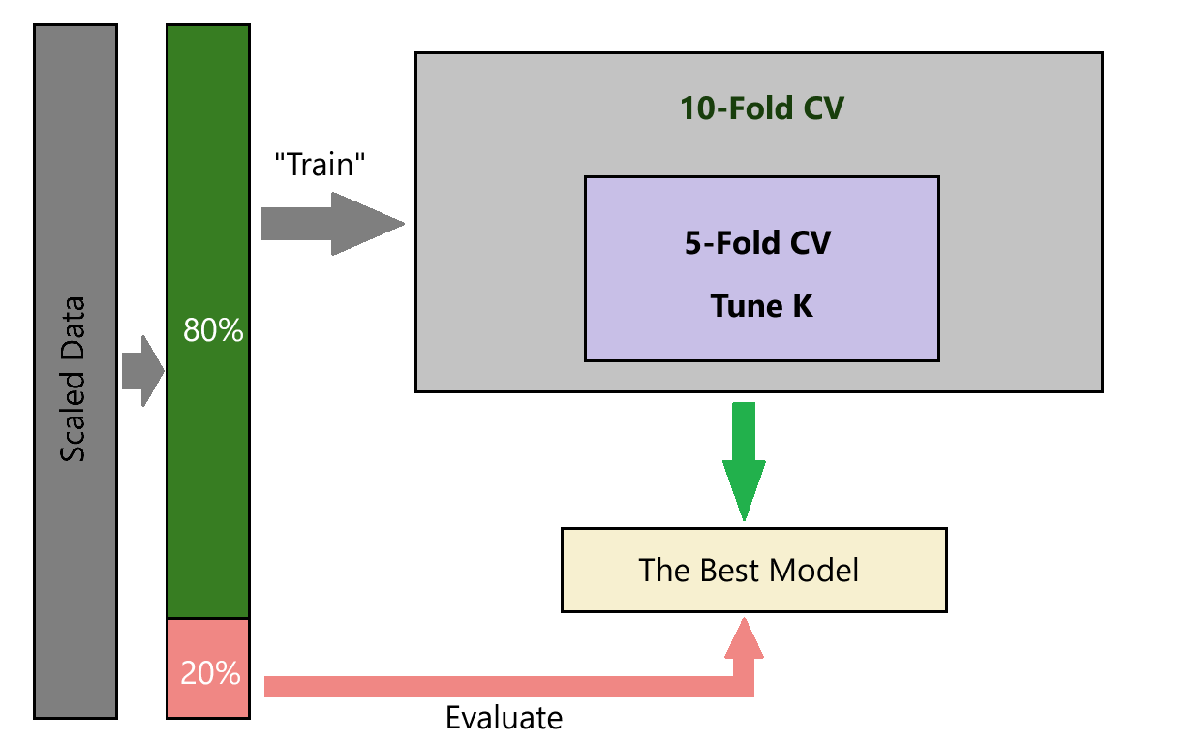
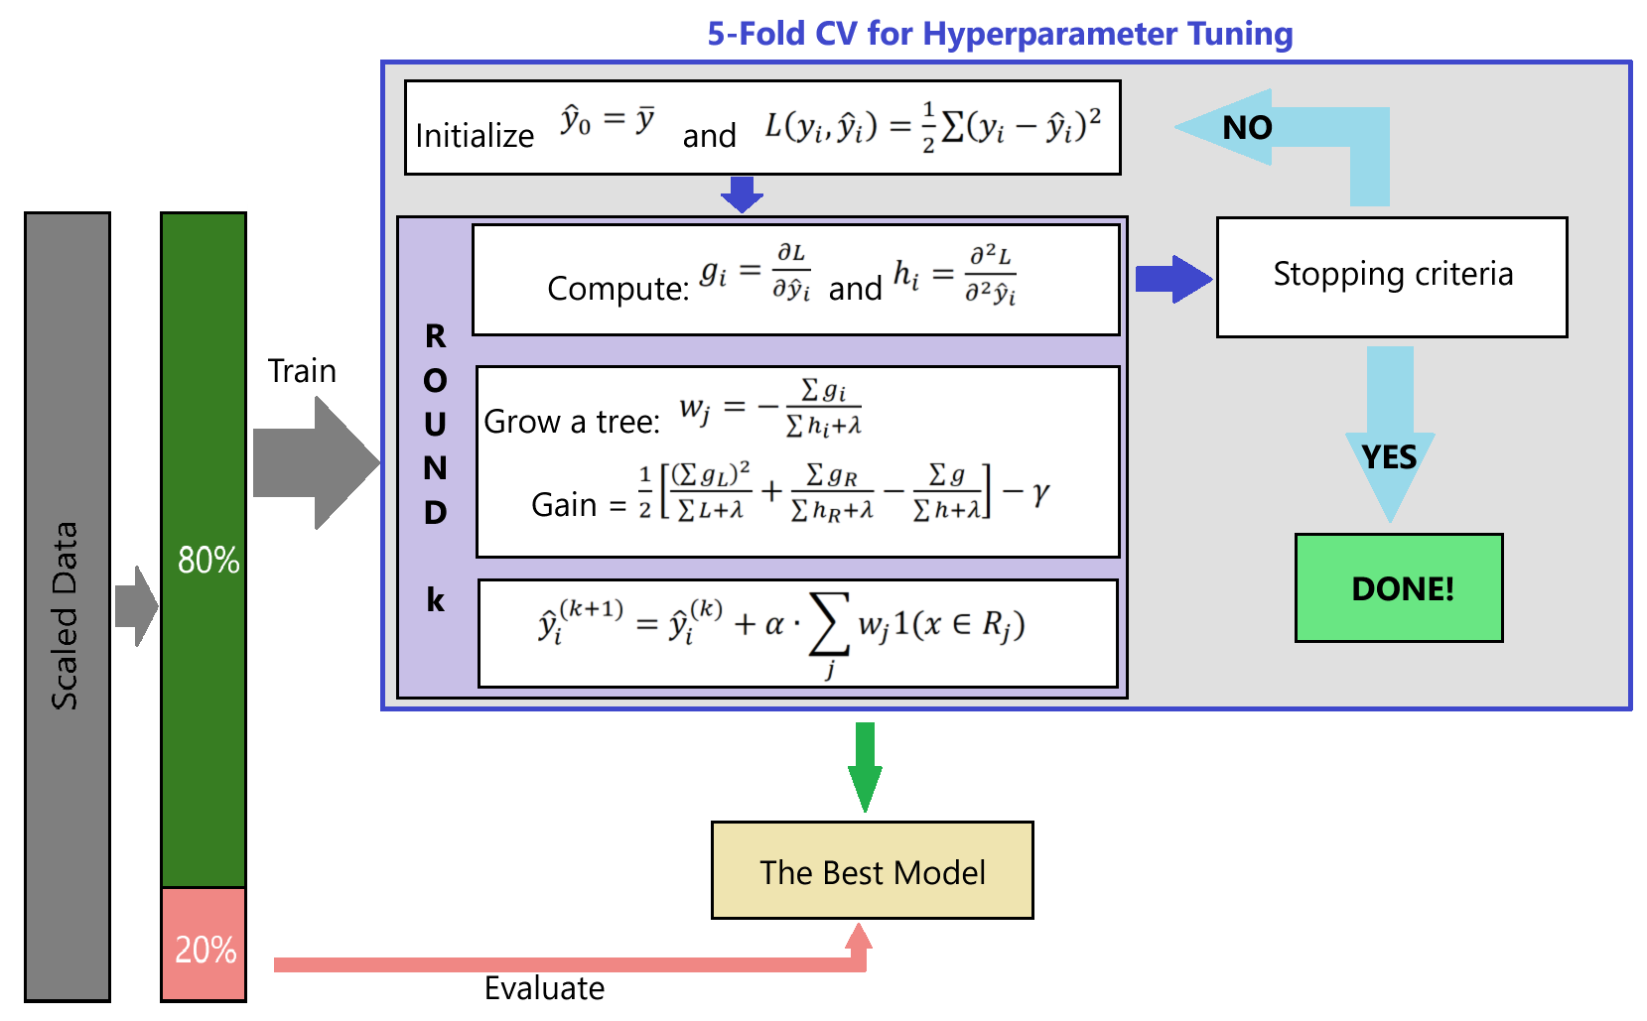
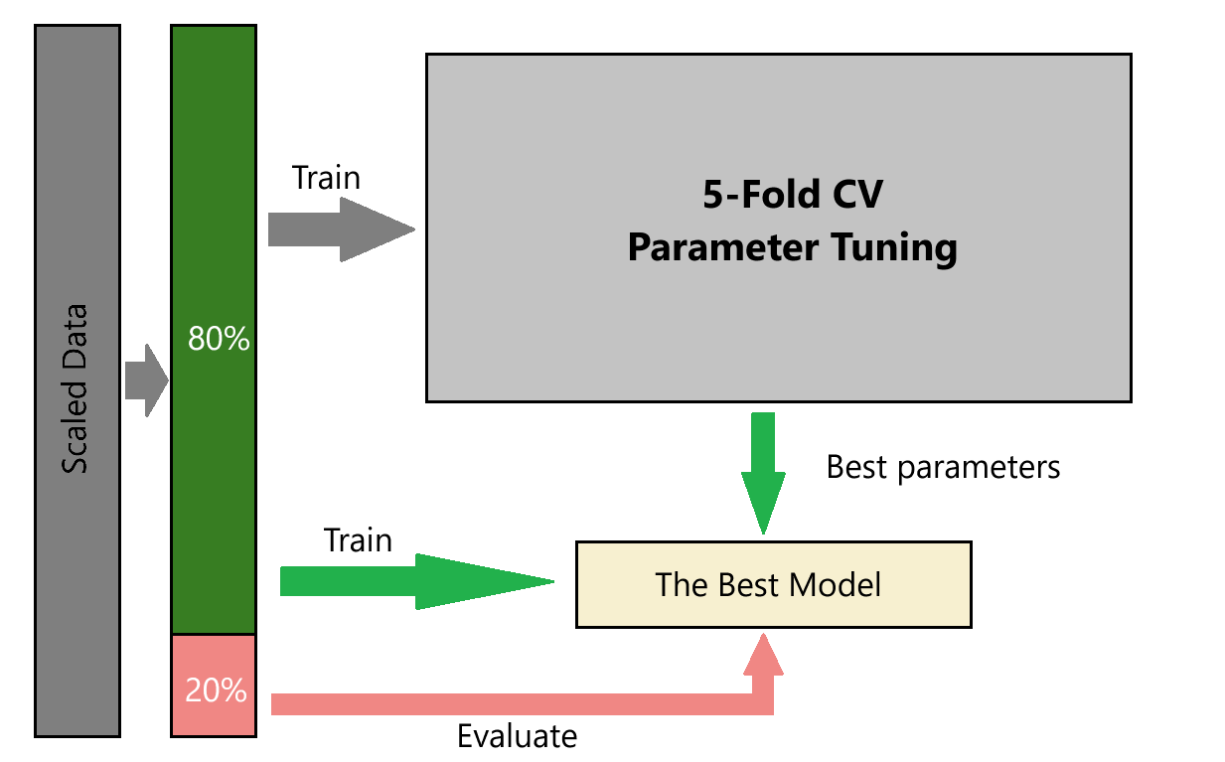
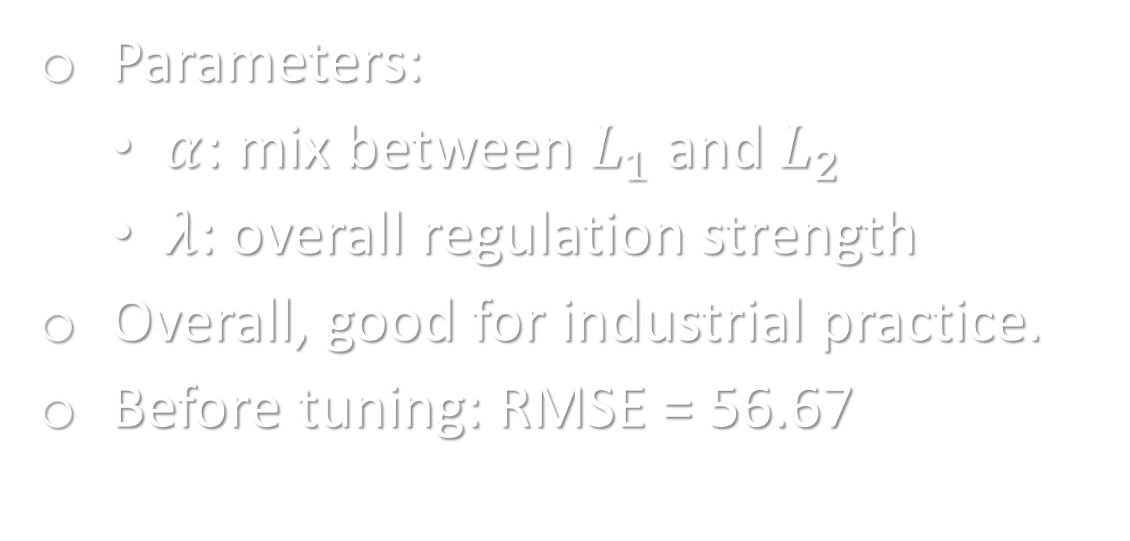
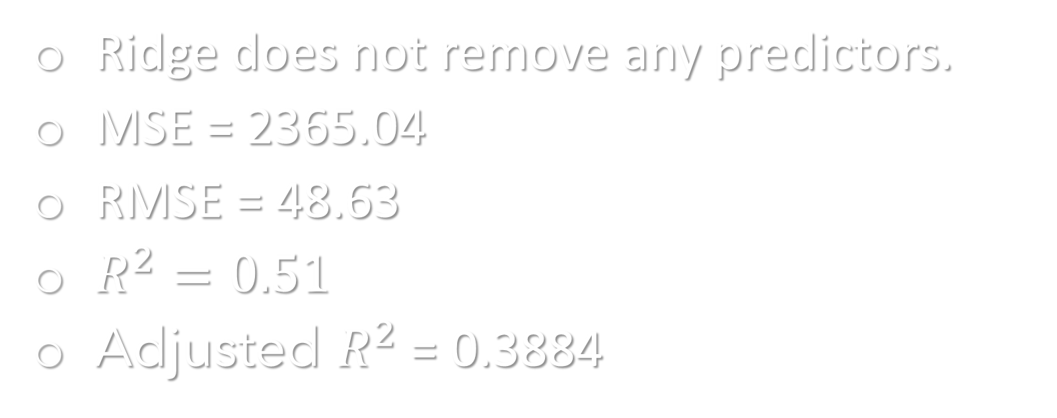
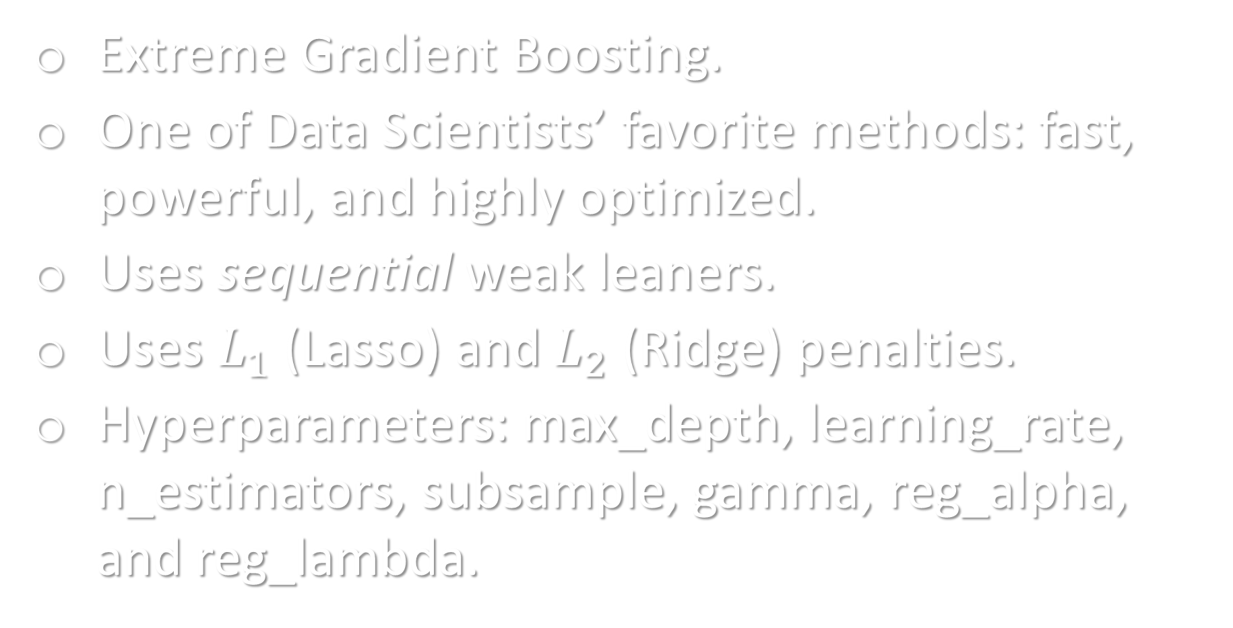
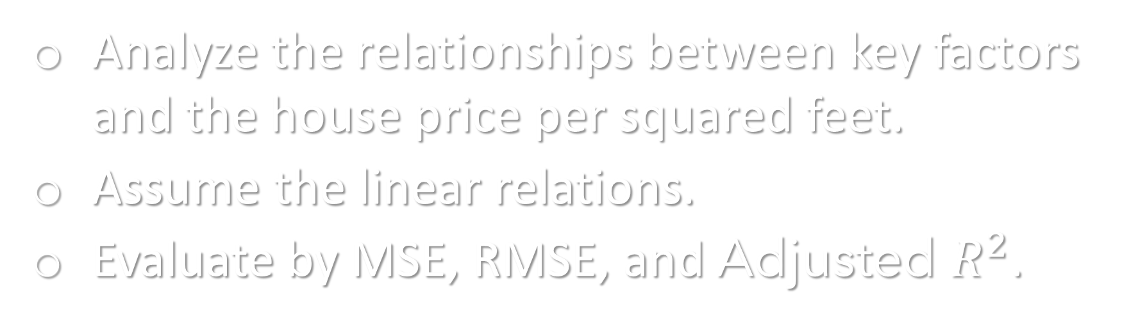
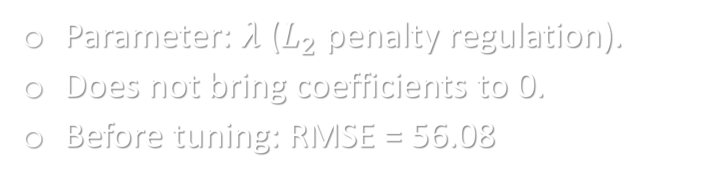
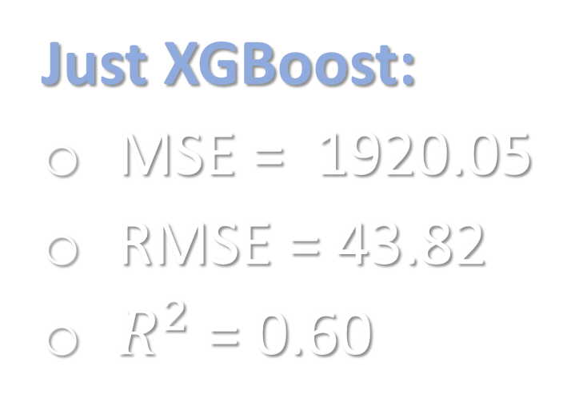
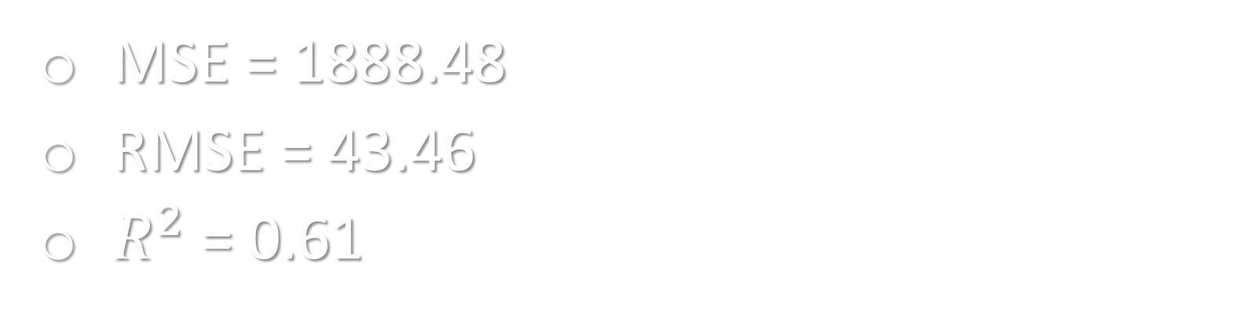
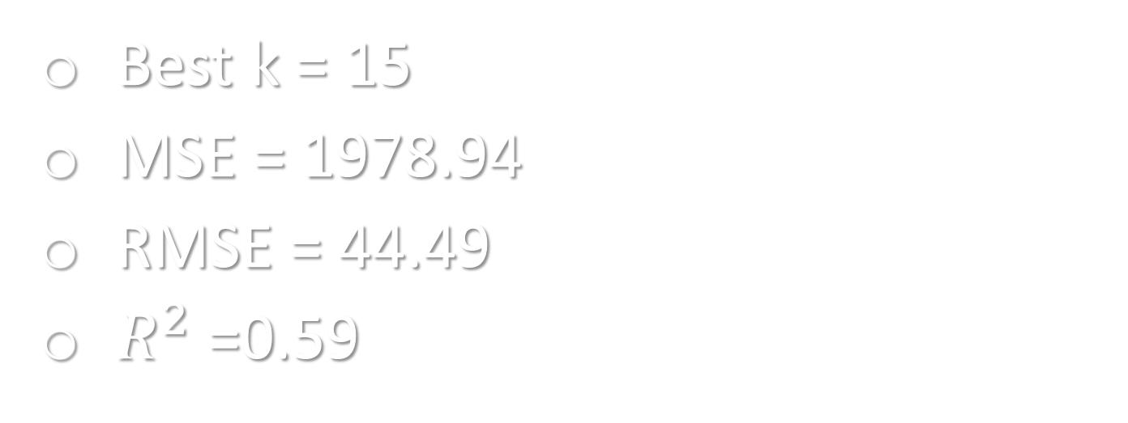
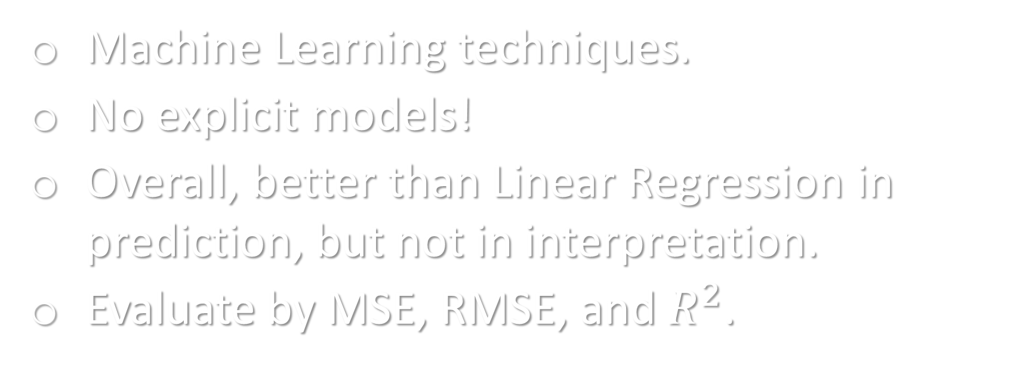
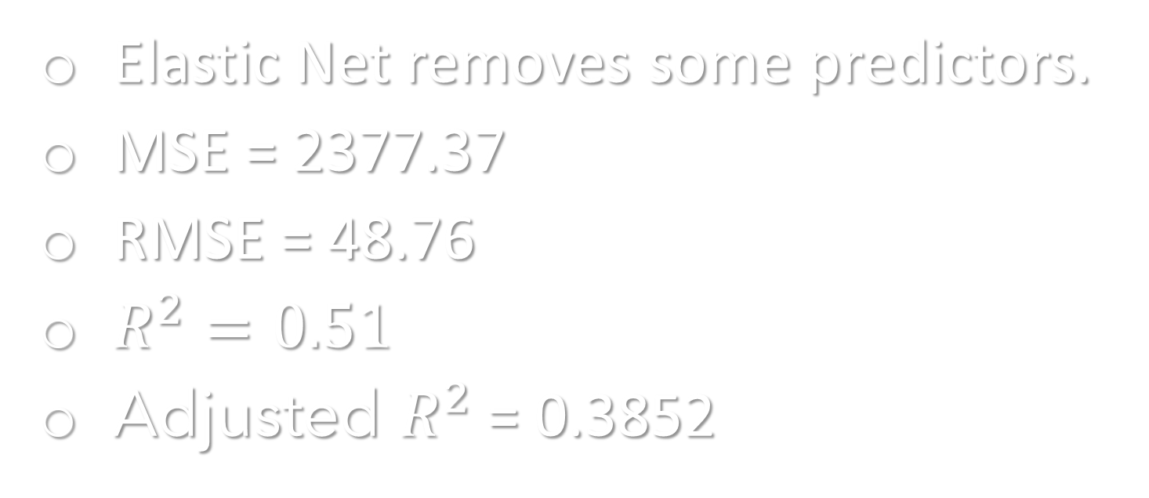
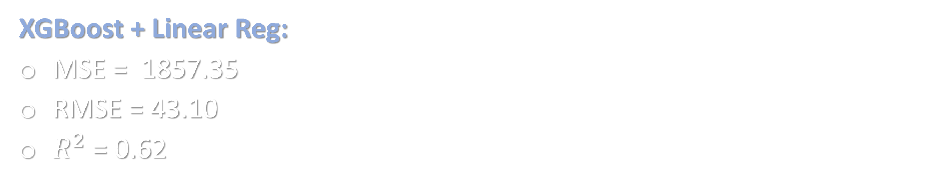
Jacksonville House Price: A Data-Driven Analysis
Anwar Hossain, Asrafi Yesmin, Vi Nguyen
Department of Mathematics & Statistics • University of North Florida
Planning to Move?
Ridge Regression
Random Forest
Parameter: $λ$ ($L_{2}$ penalty regulation).
Does not bring coefficients to 0.
Before tuning: RMSE = 56.08
Scaling is not necessary for tree-based models.
Each tree is a weak learner.
Hyperparameters: n_estimators, max_depth, min_samples_split, and max_features.
Jacksonville is the largest city in Florida.
The annual population growth is 1.15%.
House market is competitive but strong.
What factors determine house prices?
Ridge performs slightly better than Elastic Net.
But Elastic Net has simpler model.
Tuning the regulations significantly improves model performance.
Data & Methodology
Years: 2022, 2023
Zip codes: 5
Predictors: 24
Observations: 600
Language: Python
Predicted variable: PricePerSq
Mean: 197.85
Standard deviation: 81.09
Data Preparation: Min-Max Scaling, Standardization, Log Transformation
Linear Regression: Ridge Regression and Elastic Net
Non-linear Regression: Weighted KNN, Random Forest, and XGBoost
Ridge does not remove any predictors.
MSE = 2365.04
RMSE = 48.63
$R^{2}=0.51$
Adjusted $R^{2}$ = 0.3884
MSE = 1888.48
RMSE = 43.46
$R^{2}$ = 0.61
Non-linear Regression
Machine Learning techniques.
No explicit models!
Overall, better than Linear Regression in prediction, but not in interpretation.
Evaluate by MSE, RMSE, and $R^{2}$.
XGBoost
Elastic Net
Extreme Gradient Boosting.
One of Data Scientists’ favorite methods: fast, powerful, and highly optimized.
Uses sequential weak leaners.
Uses $L_{1}$ (Lasso) and $L_{2}$ (Ridge) penalties.
Hyperparameters: max_depth, learning_rate, n_estimators, subsample, gamma, reg_alpha, and reg_lambda.
Parameters:
$α$: mix between $L_{1}$ and $L_{2}$
$λ$: overall regulation strength
Overall, good for industrial practice.
Before tuning: RMSE = 56.67
Weighted KNN
K-Nearest Neighbors that prioritizes the closer neighbors.
Does not train data in the traditional way.
Stores data by Euclidean distances.
Linear Regression
Analyze the relationships between key factors and the house price per squared feet.
Assume the linear relations.
Evaluate by MSE, RMSE, and Adjusted $R^{2}$.
Elastic Net removes some predictors.
MSE = 2377.37
RMSE = 48.76
$R^{2}=0.51$
Adjusted $R^{2}$ = 0.3852
Best k = 15
MSE = 1978.94
RMSE = 44.49
$R^{2}$ =0.59
Just XGBoost:
MSE = 1920.05
RMSE = 43.82
$R^{2}$ = 0.60
XGBoost + Linear Reg:
MSE = 1857.35
RMSE = 43.10
$R^{2}$ = 0.62

